Slide 1
Job Salary Analysis for Data Professional in Malaysia

Slide 2
Data Analyst (Overall)
Salary (RM) | Lower Bound | Average | Upper Bound
Mean | 4756 | 5616 | 6477
1st Quartile (Q1) | 3000 | 3825 | 4500
Median (Q2) | 4000 | 5000 | 5500
3rd Quartile (Q3) | 5500 | 7000 | 8000
After removing outliers
Salary (RM) | Average
Mean | 5196
1st Quartile (Q1) | 3750
Median (Q2) | 4750
3rd Quartile (Q3) | 6397

Slide 3
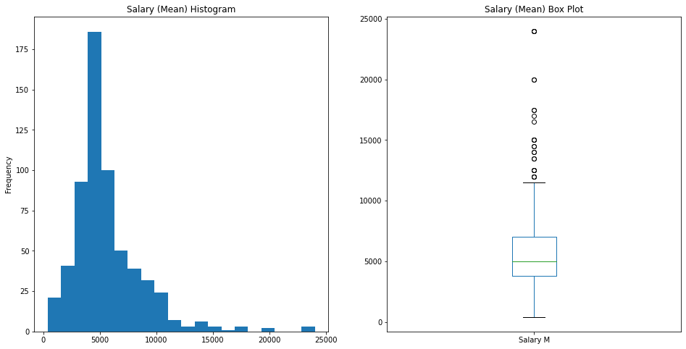
Data Analyst (Overall)

Slide 4
Data Engineer (Overall)
Salary (RM) | Lower Bound | Average | Upper Bound
Mean | 4458 | 5464 | 6470
1st Quartile (Q1) | 2500 | 3050 | 3500
Median (Q2) | 4000 | 4750 | 6000
3rd Quartile (Q3) | 5250 | 7000 | 8000
After removing outliers
Salary (RM) | Average
Mean | 5179
1st Quartile (Q1) | 3000
Median (Q2) | 4654
3rd Quartile (Q3) | 6750

Slide 5
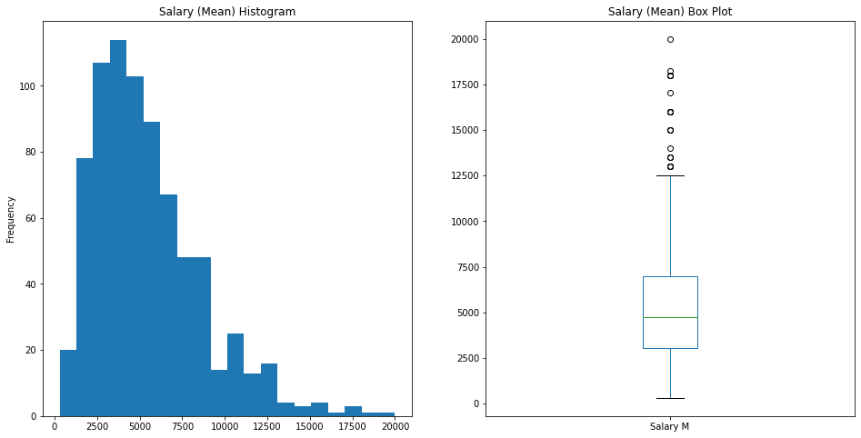
Data Engineer (Overall)

Slide 6
Data Scientist (Overall)
Salary (RM) | Lower Bound | Average | Upper Bound
Mean | 6035 | 7343 | 8652
1st Quartile (Q1) | 3500 | 4000 | 4500
Median (Q2) | 4000 | 5050 | 5500
3rd Quartile (Q3) | 8000 | 9000 | 10022
After removing outliers
Salary (RM) | Average
Mean | 6377
1st Quartile (Q1) | 4000
Median (Q2) | 4500
3rd Quartile (Q3) | 8997

Slide 7
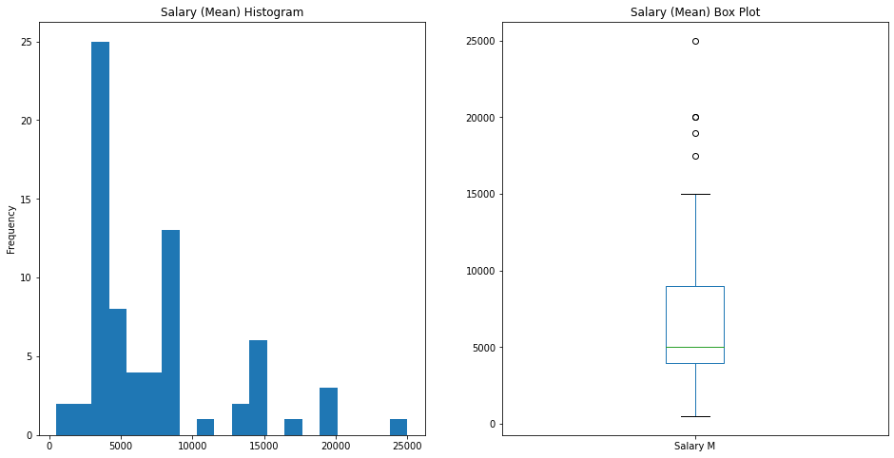
Data Scientist (Overall)

Slide 8
Machine Learning Engineer (Overall)
Salary (RM) | Lower Bound | Average | Upper Bound
Mean | 5360 | 6701 | 8041
1st Quartile (Q1) | 2550 | 3875 | 4750
Median (Q2) | 4500 | 6250 | 7500
3rd Quartile (Q3) | 9000 | 11000 | 13000
After removing outliers
Salary (RM) | Average
Mean | 6701
1st Quartile (Q1) | 3875
Median (Q2) | 6250
3rd Quartile (Q3) | 11000

Slide 9
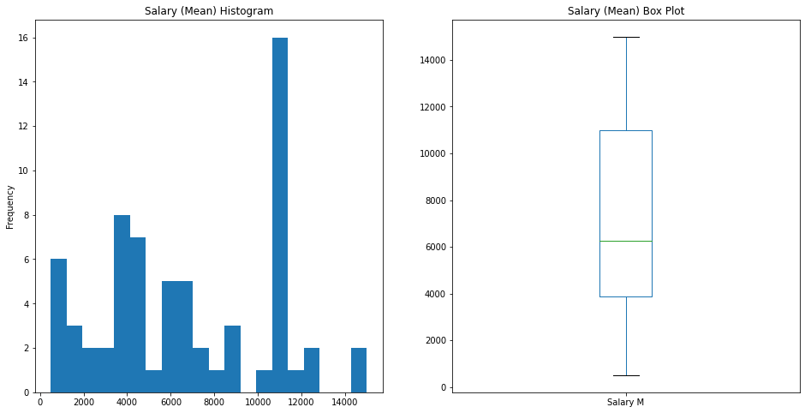
Machine Learning Engineer (Overall)

Slide 10
Data Analyst (By Level)
Salary (RM) | Junior | Mid Level | Senior
Mean | 3972 | 6212 | 6886
1st Quartile (Q1) | 3100 | 4500 | 4250
Median (Q2) | 4000 | 5625 | 6000
3rd Quartile (Q3) | 4500 | 7500 | 8188
After removing outliers
Salary (RM) | Junior | Mid Level | Senior
Mean | 3854 | 5890 | 6011
1st Quartile (Q1) | 3150 | 4500 | 4250
Median (Q2) | 4000 | 5500 | 5750
3rd Quartile (Q3) | 4250 | 7150 | 7500

Slide 11
Data Engineer (By Level)
Salary (RM) | Junior | Mid Level | Senior
Mean | 3915 | 6292 | 7338
1st Quartile (Q1) | 1988 | 4500 | 5125
Median (Q2) | 3750 | 5750 | 7250
3rd Quartile (Q3) | 5000 | 7948 | 9125
After removing outliers
Salary (RM) | Junior | Mid Level | Senior
Mean | 3463 | 6292 | 7338
1st Quartile (Q1) | 1825 | 4500 | 5125
Median (Q2) | 3750 | 5750 | 7250
3rd Quartile (Q3) | 4750 | 7948 | 9125

Slide 12
Data Scientist (By Level)
Salary (RM) | Junior | Mid Level | Senior
Mean | 4462 | 7148 | 9782
1st Quartile (Q1) | 4000 | 3500 | 4000
Median (Q2) | 4000 | 6997 | 4925
3rd Quartile (Q3) | 4500 | 9000 | 15000
After removing outliers
Salary (RM) | Junior | Mid Level | Senior
Mean | 4103 | 6638 | 9782
1st Quartile (Q1) | 4000 | 3500 | 4000
Median (Q2) | 4000 | 6744 | 4925
3rd Quartile (Q3) | 4000 | 8999 | 15000

Slide 13
Machine Learning Engineer (By Level)
Salary (RM) | Junior | Mid Level | Senior
Mean | 4410 | 7310 | 9892
1st Quartile (Q1) | 2650 | 4500 | 10750
Median (Q2) | 4000 | 7500 | 11000
3rd Quartile (Q3) | 4350 | 11000 | 11000
After removing outliers
Salary (RM) | Junior | Mid Level | Senior
Mean | 3256 | 7310 | 11000
1st Quartile (Q1) | 2163 | 4500 | 11000
Median (Q2) | 4000 | 7500 | 11000
3rd Quartile (Q3) | 4225 | 11000 | 11000

Slide 14
Overall Salary Comparison (Across Jobs)
Salary (RM) | Data Analyst | Data Engineer | Data Scientist | Machine Learning Engineer
Mean | 5616 | 5464 | 7343 | 6701
1st Quartile (Q1) | 3825 | 3050 | 4000 | 3875
Median (Q2) | 5000 | 4750 | 5050 | 6250
3rd Quartile (Q3) | 7000 | 7000 | 9000 | 11000

Slide 15
Junior Level Salary Comparison (Across Jobs)
Salary (RM) | Data Analyst | Data Engineer | Data Scientist | Machine Learning Engineer
Mean | 3972 | 3915 | 4462 | 4410
1st Quartile (Q1) | 3100 | 1988 | 4000 | 2650
Median (Q2) | 4000 | 3750 | 4000 | 4000
3rd Quartile (Q3) | 4500 | 5000 | 4500 | 4350

Slide 16
Mid Level Salary Comparison (Across Jobs)
Salary (RM) | Data Analyst | Data Engineer | Data Scientist | Machine Learning Engineer
Mean | 6212 | 6292 | 7148 | 7310
1st Quartile (Q1) | 4500 | 4500 | 3500 | 4500
Median (Q2) | 5625 | 5750 | 6997 | 7500
3rd Quartile (Q3) | 7500 | 7948 | 9000 | 11000

Slide 17
Senior Level Salary Comparison (Across Jobs)
Salary (RM) | Data Analyst | Data Engineer | Data Scientist | Machine Learning Engineer
Mean | 6886 | 7338 | 9782 | 9892
1st Quartile (Q1) | 4250 | 5125 | 4000 | 10750
Median (Q2) | 6000 | 7250 | 4925 | 11000
3rd Quartile (Q3) | 8188 | 9125 | 15000 | 11000

Slide 18
Data Analyst Sample Counts
Count | Junior | Mid Level | Senior | Total
With Salary | 226 | 331 | 174 | 614
Without Salary | 429 | 1529 | 673 | 2300
Total | 655 | 1860 | 847 | 2914

Slide 19
Data Engineer Sample Counts
Count | Junior | Mid Level | Senior | Total
With Salary | 96 | 225 | 142 | 759
Without Salary | 251 | 908 | 661 | 2634
Total | 346 | 1133 | 803 | 3393

Slide 20
Data Scientist Sample Counts
Count | Junior | Mid Level | Senior | Total
With Salary | 25 | 36 | 26 | 72
Without Salary | 56 | 220 | 119 | 348
Total | 81 | 256 | 145 | 420

Slide 21
Machine Learning Engineer Sample Counts
Count | Junior | Mid Level | Senior | Total
With Salary | 21 | 46 | 25 | 67
Without Salary | 46 | 171 | 136 | 302
Total | 67 | 217 | 161 | 369

